Slide 1
Natural Disasters Analysis
Submitted to : Dr. Santosh Singh Rathore
Done By :
BHAVANA MEKALA 2021BCS-041
NELLURI PAVITHRA SAI LAKSHMI 2021BCS-049

Slide 2
 | Introduction
 | Data Collection
 | Data Preprocessing
 | Inferences
 | Conclusion
DATA ANALYSIS
TABLE OF CONTENTS

Slide 3
INTRODUCTION
Natural disasters are events caused by natural processes of the Earth that result in significant and often catastrophic consequences for people, wildlife, and the environment. These events can be sudden or develop over time.
Earthquakes, Hurricanes (Cyclones), Tornadoes, Floods, Volcanic eruptions, Tsunamis, Droughts, Blizzards, Landslides, Heatwaves, Ice storms, Hailstorms are some common types of natural disasters.
This analysis focuses on the period from 1900 to 2021, examining the patterns and consequences of these events.
The EM-DAT database, a crucial resource, captures a century of disasters with meticulous detail, offering insights into their types, locations, and socio-economic impacts.

Slide 4
DATA COLLECTION AND UNDERSTANDING DATASET

Slide 5
DATA COLLECTION
We have collected our dataset from kaggle which is taken from EMDAT database. EMDAT is an emergency events database.
EM-DAT contains essential core data on the occurrence and effects of over 22,000 mass disasters in the world from 1900 to the present day.
Number of Samples : 16124
Number of Features : 31

Slide 6
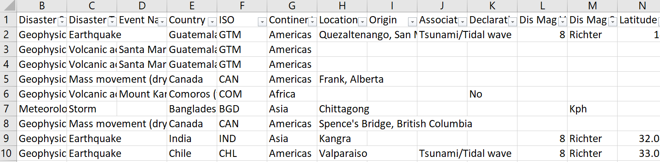
DATASET( Before DATA CLEANING )

Slide 7
Data Type of Attributes
Disaster Subgroup – Nominal
Disaster Type – Nominal
Event Name – Nominal
Country – Nominal
ISO – Nominal
Continent – Nominal
Location – Nominal
Origin – Nominal
Associated Dis – Nominal
Declaration – Nominal
Dis Mag Value – Ratio
Dis Mag Scale – Nominal
Latitude – Interval
Longitude – Interval
Local Time – Interval
River Basin – Nominal
Start Date – Interval
End Date – Interval
Total Deaths – Ratio
No Injured – Ratio
No Affected – Ratio
No Homeless – Ratio
Total Affected – Ratio
Insured Damages ('000 US$') - Ratio
Total Damages ('000 US$') - Ratio
CPI – Ratio
Year - Interval

Slide 8
DATA PREPROCESSING

Slide 9
DATA Pre-Processing
Start Day, Start Month, Start Year are combined to a single new attribute Start Date. Similarly for End Day, End Month, End Year combined to a single new attribute End Date.
Handling Missing Values :
For numerical values replaced them with mean and For categorical values replaced them with a common value or mode.
Dropped redundant or uninformative columns like Dis No etc.

Slide 10
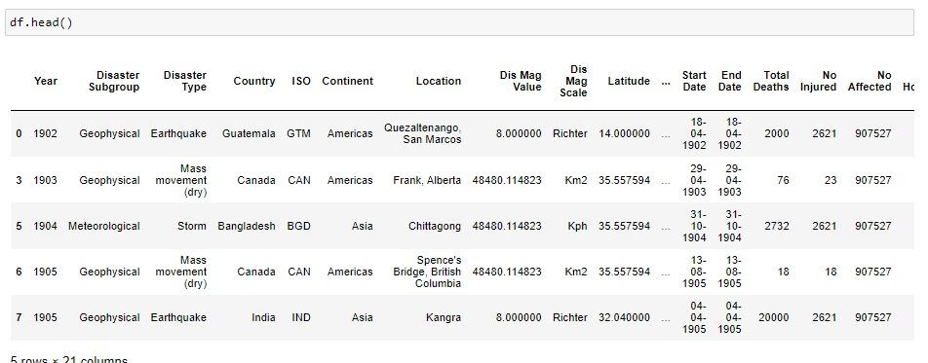
DATASET AFTER CLEANING

Slide 11
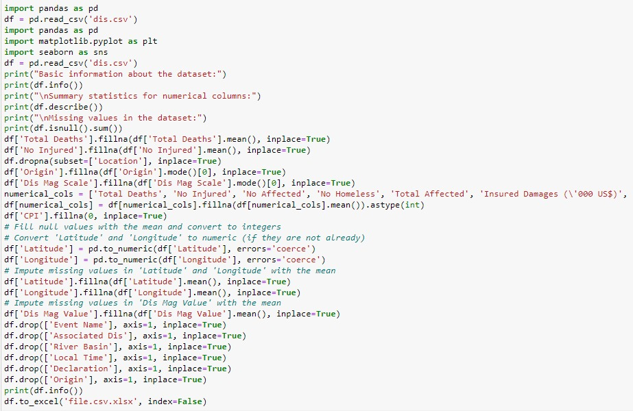

Slide 12
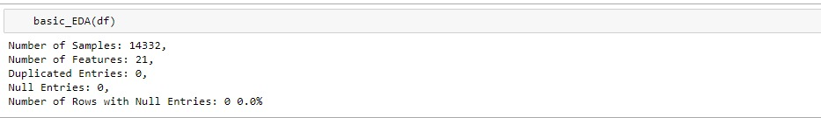
DATASET AFTER CLEANING
We can observe that before the dataset had 31 columns and now reduced to 21 columns after performing data pre-processing.
And number of samples reduced from 16124 to 14332.

Slide 13
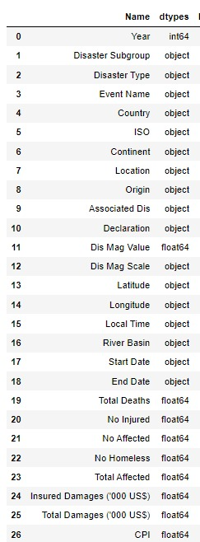
Attributes

Slide 14
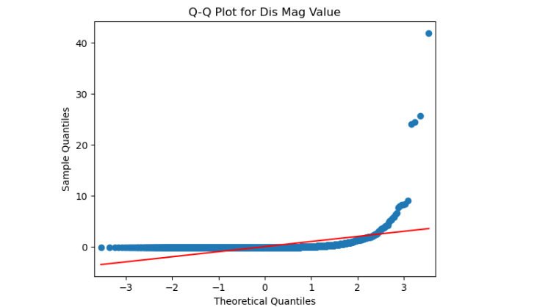
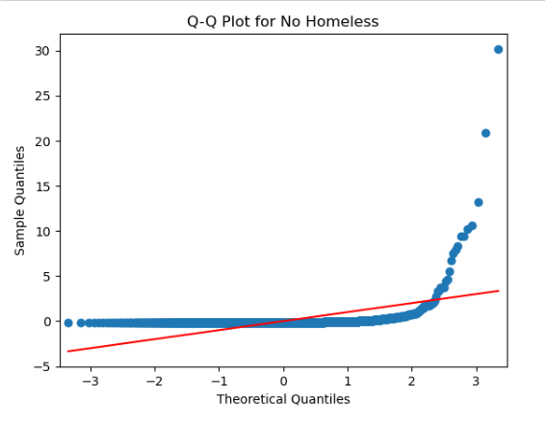
Q-Q PLOTS:

Slide 15
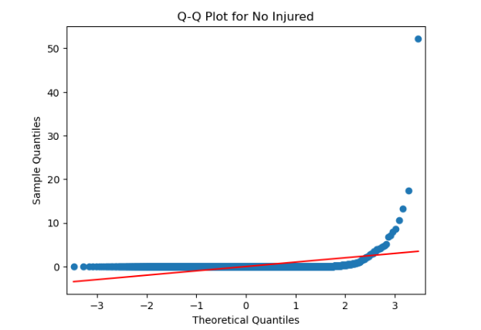
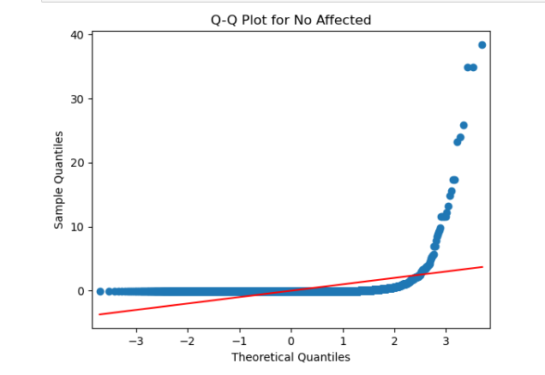
Q-Q PLOTS:

Slide 16
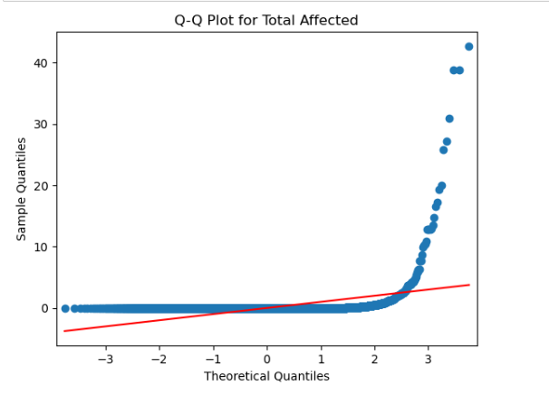
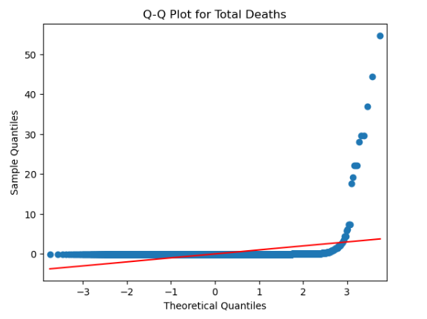
Q-Q PLOTS:

Slide 17
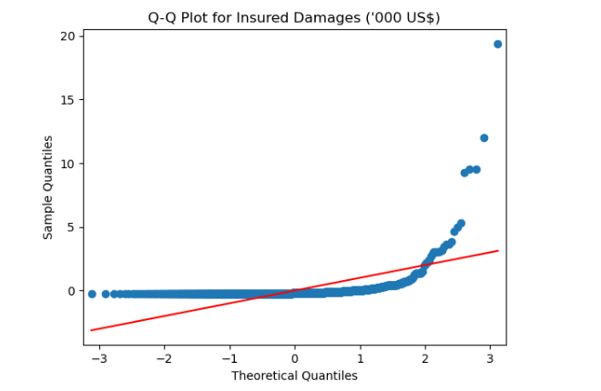
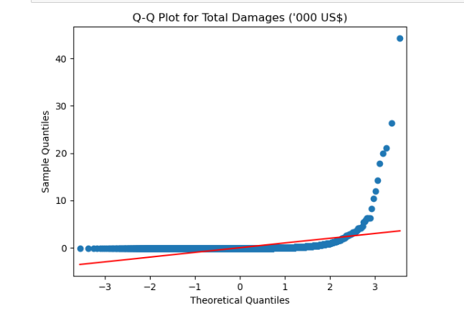
Q-Q PLOTS:

Slide 18
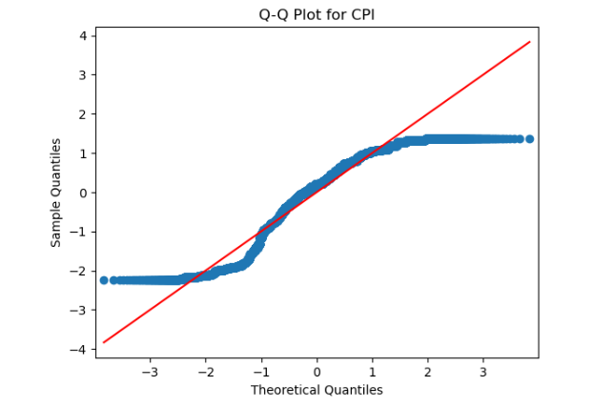
Q-Q PLOTS:

Slide 19
fiNdings
We have drawn Q-Q plots to find what tests should be used.
The Q-Q plot's visual examination reveals that the observed points differ from the predicted straight line, proving that the distribution is not normal.
A normal distribution may be assumed in statistical analysis, which may be affected by this deviation from normality.
In light of these findings, non-parametric or strong statistical alternatives might be taken into account for analyses in which the normalcy assumptions are not satisfied.

Slide 20
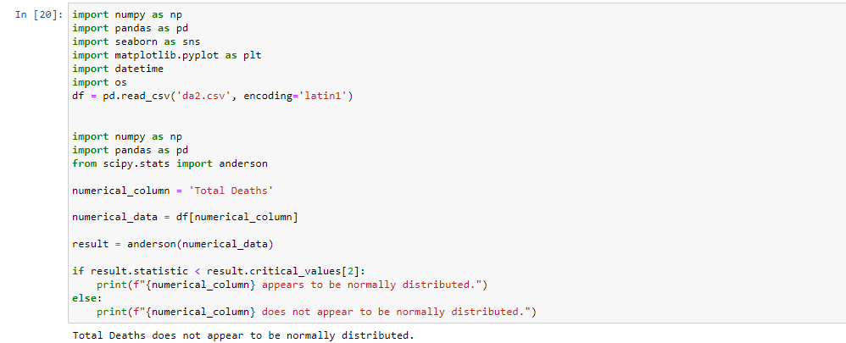

Slide 21
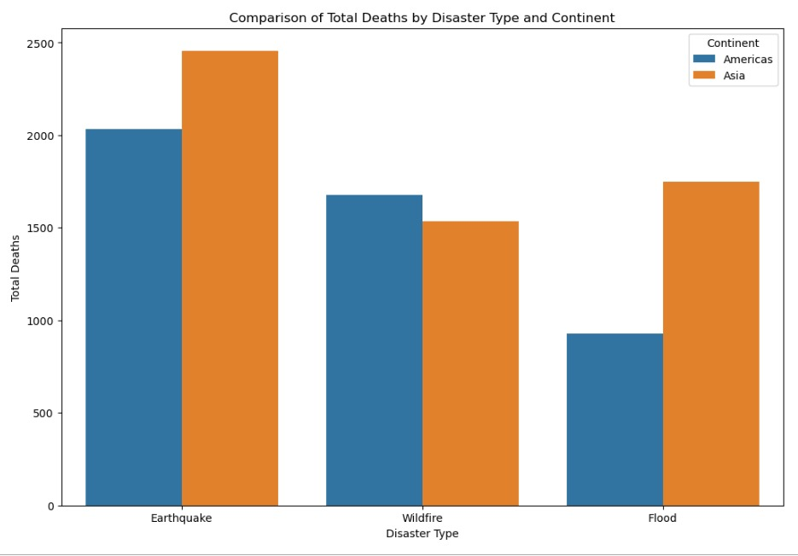
Comparison of Total Deaths by Disaster Type

Slide 22
A non-parametric test, Kruskal-Wallis test, is used to assess if two or more independent groups differ statistically significantly from one another.
It is used to determine whether there are statistically significant variations in the total deaths for each disaster subtype between the two continents in the context of your research comparing total deaths between disaster subtypes in Asia and North America.
Null Hypothesis (H0): The distributions of total deaths for each disaster subtype are the same across Asia and North America.
Alternative Hypothesis (H1): At least one group (disaster subtype) has a different distribution of total deaths between Asia and North America.

Slide 23
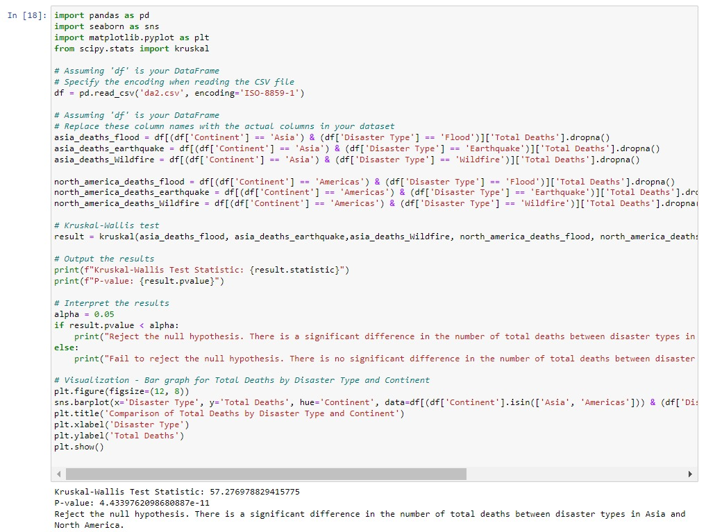

Slide 24
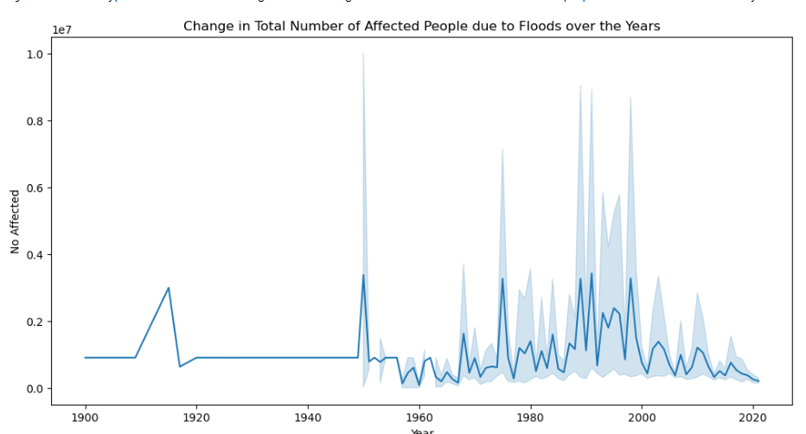
Change in Total no.of Affected People due to Floods over the years

Slide 25
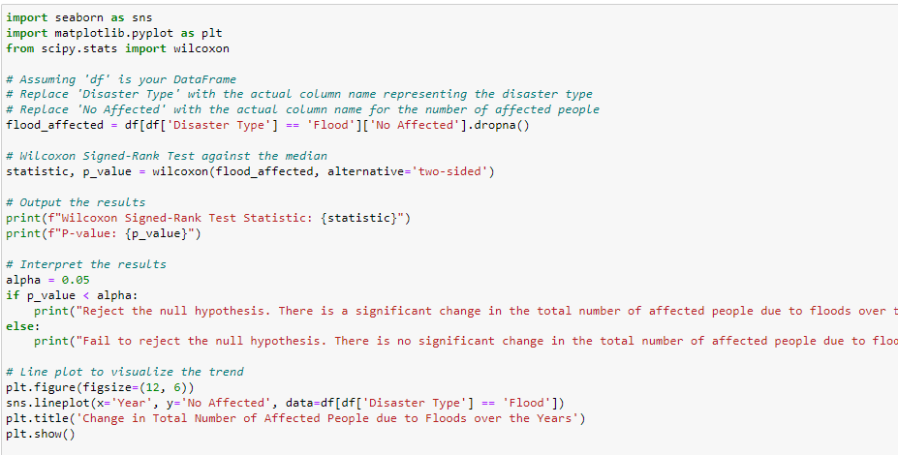

Slide 26
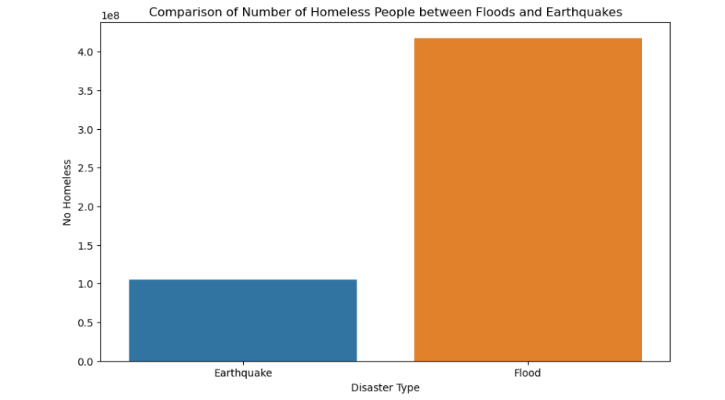

Slide 27
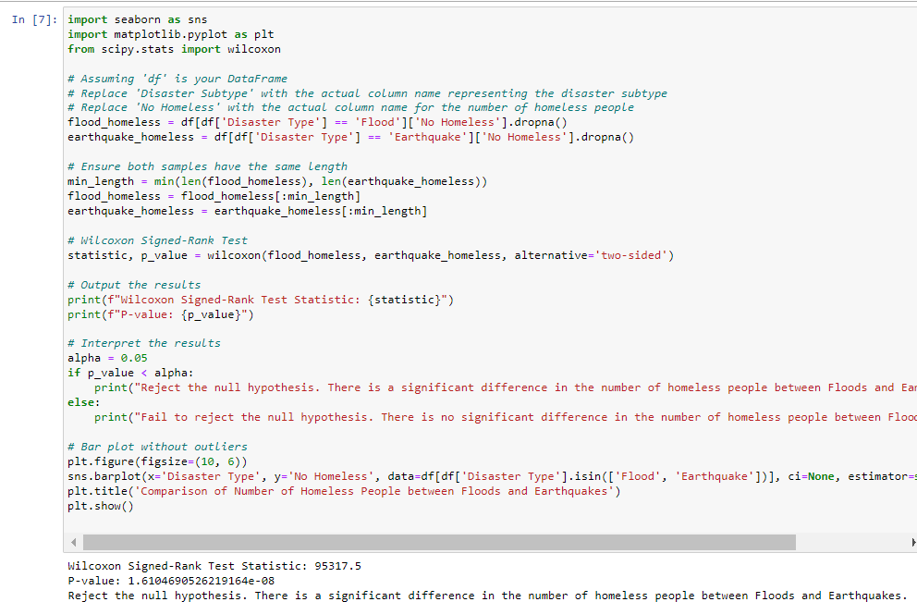

Slide 28
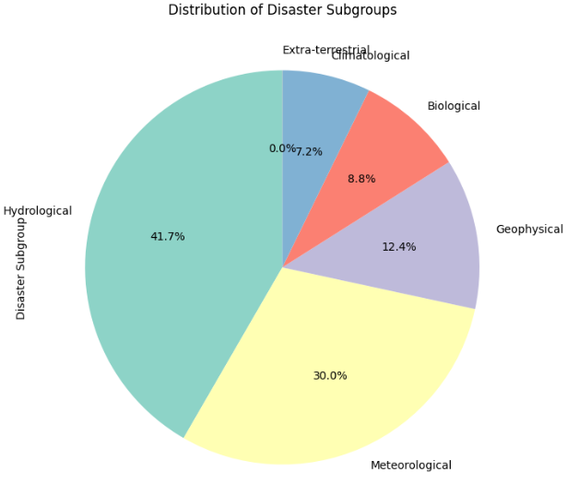

Slide 29
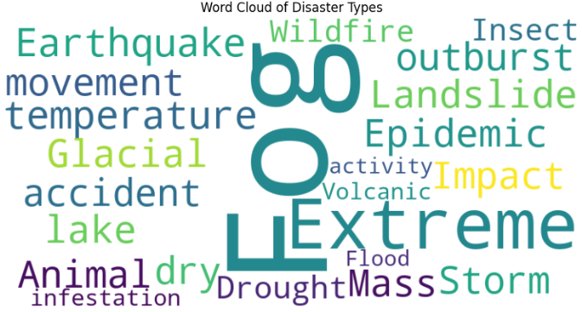
Frequency of Types of Disasters:

Slide 30

CONCLUSION
Using the EM-DAT Database, we have mapped out the history of natural disasters from 1900 to 2021.
Our analysis has revealed important new information on the intricate relationship between human cultures and the destructive force of nature.
The histories of earthquakes, storms, and other calamities have provided a clear picture of the effects on a global scale, highlighting trends, difficulties, and the adaptability of local populations everywhere.

Slide 31
Future Scope :
Predictive Modeling: Implement machine learning algorithms for predictive modeling.
Impact of Climate Change: Take data on climate change into account when evaluating how it affects the frequency and severity of natural catastrophes. Examine any connections between climatic trends and the incidence of disasters.
Interdisciplinary Investigations: For a comprehensive understanding, work in conjunction with social scientists, geographers, and environmental scientists. Combine information from several sources to improve the analysis.

Slide 32
THANK YOU

